Slide 1
Optimal Control of DC Motor using Linear Quadratic Regulator
Linear System Control
Term project presentation – Group 9
June 17, 2019
Professor : Kyoung Kwan Ahn
Student : Chen Man - 20185108
Pham Thanh Tuan - 20175312

Slide 2
Outline
Introduction
Linear Quadratic Regulator
DC Motor Model
Simulation Results
Conclusion

Slide 3
Introduction
Objective: Control angular speed of a DC motor model using different control strategies like Closed Loop system and Linear Quadratic Regulator for comparison purpose.
Controller methods:
PID
Linear Quadratic Regulator
Model Predictive Control

Slide 4

Linear Quadratic Regulator (LQR)
LQR problem considers the state-space system and given by
$$\dot{x}=Ax+Bu$$
$$J= \int_{0}^{∞}{\left(x^{T}Qx+u^{T}Ru\right)dt}$$
Where $Q≥0, R>0$are symmetric, positive definite matrix. $Q$ and $R$ are weighting factors.
(1)
(2)
Notes:
LQR control that designed is classified as optimal control systems.
This is an important function of control engineering.

Slide 5

Linear Quadratic Regulator (LQR)
Solve via maximum principle:
$$H= x^{T}Qx+u^{T}Ru+λ^{T}\left(Ax+Bu\right)$$
$\dot{x}={\left(\frac{∂H}{∂λ}\right)}^{T}=Ax+Bu$
$−\dot{λ}={\left(\frac{∂H}{∂x}\right)}^{T}=Qx+A^{T}λ$
$0=\frac{∂H}{∂u}=Ru+λ^{T}B⟺u=−R^{−1}B^{T}λ.$
Assume, $λ\left(t\right)=P(t)x\left(t\right)$. Then,
$$\dot{λ}=\dot{P}x+P\dot{x}=\dot{P}x+P(Ax−BR^{−1}B^{T}Px)$$
$$⟺−\left(Qx+A^{T}Px\right)=\dot{P}x+PAx−PBR^{−1}B^{T}Px$$
$$⟺\left(\dot{P}+PA+A^{T}P−PBR^{−1}B^{T}P+Q\right)x=0$$
(3)
(4)
(5)
(6)
(7)
(8)
Notes:
LQR control that designed is classified as optimal control systems.
This is an important function of control engineering.

Slide 6

Linear Quadratic Regulator (LQR)
The optimal control minimizing J is given by linear state feedback law
$u\left(t\right)=−Kx(t)$ with $K=R^{−1}B^{T}P$
Where $P$ is determined from the solution of equation:
$$PA+A^{T}P−PBR^{−1}B^{T}P+Q=0$$
(9)
(10)
Algebraic Riccati equation
Notes:
LQR control that designed is classified as optimal control systems.
This is an important function of control engineering.

Slide 7
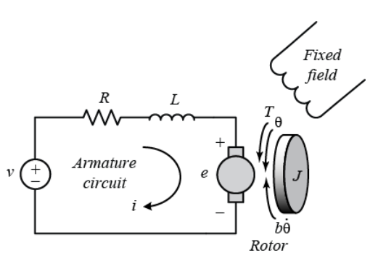

DC Motor Model
The electric equivalent circuit of a DC motor armature is based on the fact that armature winding has a resistance R, a self-inductance L, and the back emf (back electromotive force) e.
The motor torque $T$ is related to armature current $i$, by a torque constant $K_{i}$:
$$T=K_{i}i$$
The back emf, $e$, is to relative to angular velocity of the shaft by a constant factor $K_{e}$:
$$e=K_{e}\dot{θ}$$
(11)
(12)
Fig. 1 DC motor model.
Notes:
For binary classification, the basic idea of SVM is to find an hyper-plane which separates positive and negative training observations and maximizes the margin between these observations and the hyper-plane.
Linear kernel: $K(xi,x)=xiT.x$
Polynomial kernel:$K\left(xi,x\right)\text{=}{\left(γ{.x}_{i}^{T}.x+r\right)}^{d},γ$>0. $γ, r$and d parameters of the kernel function.

Slide 8

DC Motor Model
Apply the Newton’s law and Kirchoff’s law, we can write the following equations:
$$J\ddot{θ}+b\dot{θ}=K_{i}i$$
$$L\frac{di}{dt}+Ri=V−K_{e}\dot{θ}$$
According to equations above, the state space model will be:
$$\frac{d}{dx}\left[\begin{matrix}\dot{θ} \\ i\end{matrix}\right]=\left[\begin{matrix}−\frac{b}{J} & \frac{K_{i}}{J} \\ −\frac{K_{e}}{L} & −\frac{R}{L}\end{matrix}\right]\left[\begin{matrix}\dot{θ} \\ i\end{matrix}\right]+\left[\begin{matrix}0 \\ \frac{1}{L}\end{matrix}\right]V$$
$$y=\left[\begin{matrix}1 & 0\end{matrix}\right]\left[\begin{matrix}\dot{θ} \\ i\end{matrix}\right]$$
(13)
(14)
(15)
A
B
(16)
C
Notes:
For binary classification, the basic idea of SVM is to find an hyper-plane which separates positive and negative training observations and maximizes the margin between these observations and the hyper-plane.
Linear kernel: $K(xi,x)=xiT.x$
Polynomial kernel:$K\left(xi,x\right)\text{=}{\left(γ{.x}_{i}^{T}.x+r\right)}^{d},γ$>0. $γ, r$and d parameters of the kernel function.

Slide 9

DC Motor Model
Apply the Laplace transform, the modeling equations can be expressed as follows:
$$s\left(Js+b\right)Θ\left(s\right)=K_{i}I\left(s\right)$$
$$\left(Ls+R\right)I\left(s\right)=V\left(s\right)−K_{e}sΘ\left(s\right)$$
According to equations above, the open-loop transfer function of the motor is obtained by:
$$P\left(s\right)=\frac{\dot{Θ}(s)}{V(s)}=\frac{K_{i}}{\left(Js+b\right)\left(Ls+R\right)+K_{e}K_{i}}$$
(17)
(18)
(19)
Notes:
For binary classification, the basic idea of SVM is to find an hyper-plane which separates positive and negative training observations and maximizes the margin between these observations and the hyper-plane.
Linear kernel: $K(xi,x)=xiT.x$
Polynomial kernel:$K\left(xi,x\right)\text{=}{\left(γ{.x}_{i}^{T}.x+r\right)}^{d},γ$>0. $γ, r$and d parameters of the kernel function.

Slide 10

















Simulation Results
$$V(s)$$
$$+$$
$$\frac{1}{Ls+R}$$
$$i(s)$$
$$T(s)$$
$$\frac{1}{Js+b}$$
$$\dot{θ}(s)$$
$$ $$
$$K_{i}$$
$$−$$
$$e(s)$$
$$K_{e}$$
Fig. 2 DC motor system block diagram for speed control.
$$x$$
$$\dot{x}=Ax+Bu$$
$$C$$
$$y$$
$$u=−Kx$$
Fig. 3 Linear Quadratic Regulator structure.
Notes:
For binary classification, the basic idea of SVM is to find an hyper-plane which separates positive and negative training observations and maximizes the margin between these observations and the hyper-plane.
Linear kernel: $K(xi,x)=xiT.x$
Polynomial kernel:$K\left(xi,x\right)\text{=}{\left(γ{.x}_{i}^{T}.x+r\right)}^{d},γ$>0. $γ, r$and d parameters of the kernel function.

Slide 11
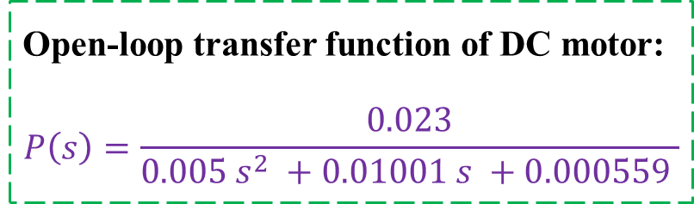
Simulation Results
Particulars | Value and unit
Moment of inertia, J | 0.01 kg.m²
Viscous friction constant, b | 0.00003 N.m.s
Back emf constant K_{e} | 0.023 V/rad/s
Torque constant, K_{t} | 0.023 N.m/A
Armature Resistance, R | 1 Ω
Armature Inductance, L | 0.5 H
Table I.
Separately excited DC Motor Specifications.
Open-loop transfer function of DC motor:
$$P\left(s\right)=\frac{0.023}{0.005 s^{2} +0.01001 s +0.000559 }$$
State space representation system matrix:
A = [- 0.003 2.3; -0.046 -2]; B = [0; 2];
C = [1 0]; D = [0].

Slide 12
Simulation Results
MATLAB codes:
% DC Motor specifications
J = 0.01; % kgm^2
Km = 0.023; % torque constant &
back emf constant
b = 0.00003; % Nms
R = 1; % Ohms
L = 0.5; % Henry
% The open-loop transfer function
s = tf('s');
P_motor = Km /((J*s + b)*(L*s + R) + Km^2);
% Closed loop system
sys_cl = feedback(P_motor,1);
t = 0:0.01:10;
step(sys_cl,t);
Fig. 4 Step response of closed loop system with unity feedback.
Notes:
For binary classification, the basic idea of SVM is to find an hyper-plane which separates positive and negative training observations and maximizes the margin between these observations and the hyper-plane.
Linear kernel: $K(xi,x)=xiT.x$
Polynomial kernel:$K\left(xi,x\right)\text{=}{\left(γ{.x}_{i}^{T}.x+r\right)}^{d},γ$>0. $γ, r$and d parameters of the kernel function.

Slide 13
Simulation Results
MATLAB codes:
% State-space system
A = [-b/J Km/J
-Km/L -R/L];
B = [0; 1/L];
C = [1 0];
D = 0;
sys = ss(A,B,C,D); % state-space
% Linear Quadratic Regulator (LQR)
Q = [0.1 0; 0 0.0001];
R_opt = 0.1;
K_opt = lqr(A,B,Q,R_opt); % Kalman gain
sys_lqr = ss(A-B*K_opt,B,C,0);
t = 0:0.01:10;
step(sys_lqr,t);
Fig. 5 Step response of optimal control using LQR.

Slide 14
Simulation Results
Fig. 6 Comparison of step response between closed loop system and LQR control.

Slide 15
Simulation Results
Table II.
Comparison of simulation results.
Different Controllers | Setting time, T_{s} | Peak Amplitude | Maximum Overshoot, Mp
Closed loop with unity feedback | 3.83 s | 1.17 | 19.5
LQR controller | 1.91 s | 1.00 | 0.77
The motor performance with LQR control is better than compared with the closed loop system.
Notes:
Table 2 shows that the motor performance with optimal control is best suited because the performance measures such as settling time and peak amplitude are shorter and smaller with maximum overshoot.

Slide 16
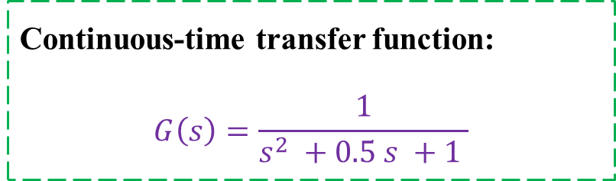
Simulation Results
MATLAB codes:
% The open-loop transfer function
s = tf('s');
G = 1/(s^2 + 0.5*s + 1);
% State-space systems
[A,B,C,D] = ssdata(G);
t = 0:0.01:50;
step(G,t);
Continuous-time transfer function:
$$G\left(s\right)=\frac{1}{s^{2} +0.5 s +1 }$$
Fig. 7 Step response.
Notes:
For binary classification, the basic idea of SVM is to find an hyper-plane which separates positive and negative training observations and maximizes the margin between these observations and the hyper-plane.
Linear kernel: $K(xi,x)=xiT.x$
Polynomial kernel:$K\left(xi,x\right)\text{=}{\left(γ{.x}_{i}^{T}.x+r\right)}^{d},γ$>0. $γ, r$and d parameters of the kernel function.

Slide 17
Simulation Results
MATLAB codes:
% Linear Quadratic Regulator (LQR)
Q = cell(1,3); R = [0.1; 0.0001];
Q{1} = [0.1 0; 0 0.0001];
Q{2} = [0.0001 0; 0 0.1];
Q{3} = [0.1 0; 0 0.1];
K = zeros(6,2);
for j = 1:2
for i = 1:3
K(3*(j-1)+i,:) = lqr(A,B,Q{i},R(j));
end
end
for i = 1:6
sys_lqr = ss(A-B*K(i,:),B,C,0);
t = 0:0.01:50;
step(sys_lqr,t);
hold on;
end
Fig. 8 Step response of optimal control using LQR.
Notes:
For binary classification, the basic idea of SVM is to find an hyper-plane which separates positive and negative training observations and maximizes the margin between these observations and the hyper-plane.
Linear kernel: $K(xi,x)=xiT.x$
Polynomial kernel:$K\left(xi,x\right)\text{=}{\left(γ{.x}_{i}^{T}.x+r\right)}^{d},γ$>0. $γ, r$and d parameters of the kernel function.

Slide 18
Conclusion
An approach to control design of a DC motor based on LQR control design.
Mechanical and electrical parameters of DC motor are used to obtain response for system.
LQR design provides an optimal state feedback control that minimizes the quadratic error and control effort.

Slide 19
Thank you for your attention

